Slide 2
The Human Development Index (HDI)
Is a composite measure of human development
First introduced by the United Nations Development Programme (UNDP) in 1990.
The HDI takes into account three basic dimensions of human development:
a long and healthy life (life expectancy at birth)
Access to education (years of schooling), and
Decent standard of living (gross Income per capita).

Slide 3
The Human Development Index (HDI)
Good Education
Good Health
Good Income
for all Population across the Globe

Slide 4
24x7 Education @ DewSoft
Sensible and Practical
Soft Skills
To Prepare you to Understand Communicate, Negotiate more Effectively
Technology Skills
To Understand Computers and Technology and use it to manage & optimize your Time Effectively
English Language Learning
To Learn and Use the Language to Grow around the World
Professional Courses
To Reach and Exceed your Career goals, whatever they may be
Testing Centre
To Test and Improve Your Knowledge and Brain Activity
Resource Centre
Your access to General Contracts, Laws, Test papers, e-Books, Stories, Activities, Ideas for All Round Development

Slide 5
Health @ DewSoft
03 Times Nutrition
through DewVital
Brain Dev.
Fulfils Special Demands of the Growing Body and Development of Brain from 2-16 years
Builds Immunity, Energy, Stamina and Enhanced Awareness for 02-85 years
Builds Immunity, Energy and Stamina for Pregnant Women and New Mothers
Assists in Tissue Repair, Body Healing, faster recovery for patients
Assists in Building Muscle, and increasing Stamina for training Athletes and Sports person

Slide 6
Best Income Only @ DewSoft
You
Direct Refer
They Refer
They Refer
Direct Refer
They Refer
Referral Leading to Income
Learn
Practice
Teach
Grow
Your Own
eCommerce Business
Company
You
Consumer

Slide 7
What makes DewSoft So Powerful?
It is the Winning Combination of
No Inventory
eCommerce Biz
Best Possible Income
Binary Direct Selling
eLearning
Self Study Books
Best Education
eTest
Fitness Tips
Online Yoga
Good Health
Nutrition Supplement
+
+

Slide 8
The Winning Mantra:
For the Leader
Set Clear Goals and Expectations: It is essential to set clear and achievable goals for your team, and communicate them effectively.
Foster Open Communication: Encourage your team members to communicate openly and frequently.
Lead by Example: Be a positive role model for your team. Show them the behavior and attitude that you expect from them.
Empower your Team: Give your team members the autonomy and freedom to make decisions and take ownership of their work.
Build Trust: Establish trust and mutual respect with your team.
Recognize and Reward Success: Acknowledge and celebrate the successes of your team.
Continuously Learn and Grow: Be open to learning new things and growing as a leader. Seek feedback from your team and be willing to make changes and adapt to new situations.
Notes:
Set clear goals and expectations: It is essential to set clear and achievable goals for your team, and communicate them effectively. Ensure that everyone on the team understands their roles and responsibilities.
Foster open communication: Encourage your team members to communicate openly and frequently. Encourage feedback and be open to suggestions and ideas.
Lead by example: Be a positive role model for your team. Show them the behavior and attitude that you expect from them. Be proactive, accountable, and take responsibility for your actions.
Empower your team: Give your team members the autonomy and freedom to make decisions and take ownership of their work. Provide them with the tools, resources, and support they need to succeed.
Build trust: Establish trust and mutual respect with your team. Encourage transparency and honesty, and be a good listener. Respect the opinions and ideas of others.
Recognize and reward success: Acknowledge and celebrate the successes of your team. Provide recognition and rewards for exceptional work and contributions.
Continuously learn and grow: Be open to learning new things and growing as a leader. Seek feedback from your team and be willing to make changes and adapt to new situations.

Slide 9
The Winning Mantra:
For the Team Member
Prepare Yourself: Know your Product, and Industry
Communicate Effectively: Listen actively and share your thoughts and ideas clearly and concisely.
Be Reliable: Be dependable and reliable. Follow through on your commitments and be punctual.
Respect Others: Respect the opinions, ideas, and contributions of your team members.
Collaborate: Work collaboratively with your team members. Be willing to compromise and find solutions that work for everyone.
Be Proactive: Take initiative and be proactive. Look for ways to help the team achieve its goals.
Build Trust: Build trust with your team members. Be honest, transparent, and respectful.
Maintain a Positive Attitude: Be optimistic, supportive, and encouraging.
Embrace Feedback: Be open to feedback and constructive criticism. Use feedback to improve your skills and contribute more effectively to the team.
Notes:
Communicate effectively: Communication is crucial for any team to function effectively. Listen actively and share your thoughts and ideas clearly and concisely.
Be reliable: Be dependable and reliable. Follow through on your commitments and be punctual.
Respect others: Respect the opinions, ideas, and contributions of your team members. Be open-minded and accepting of different perspectives.
Collaborate: Work collaboratively with your team members. Be willing to compromise and find solutions that work for everyone.
Be proactive: Take initiative and be proactive. Look for ways to help the team achieve its goals, and offer to take on additional responsibilities when needed.
Build trust: Build trust with your team members. Be honest, transparent, and respectful.
Maintain a positive attitude: A positive attitude can go a long way in creating a positive work environment. Be optimistic, supportive, and encouraging.
Embrace feedback: Be open to feedback and constructive criticism. Use feedback to improve your skills and contribute more effectively to the team.

Slide 10
The Winning Mantra:
Be Customer Focussed
Identify the Needs of the Customer: Married, Children, Education, Monthly Household Income, Friends, Social Recognition, Annual Holidays, Health, Diseases etc.
Gather Information: Collect all relevant information and data related his Needs of Education, Health, Energy, Stamina, which can be aided by Nutrition, Increase in Income or Time.
Propose a Customized Solution: Determine the essential need. This will help you propose a more effective customized solution using DewSoft Product
Showcase the Product: Use the Testing Centre to test the knowledge of Children in Household, Talk about DewVital, and its long term benefits.
Discuss the Business Later: Promote the product, the Business will fall through.
Effective Closing: Finalize the chosen Package, and Register the Prospect Online. Clearly outline the steps that need to be taken to utilize the product most effectively
Follow Up: If not closed on the first pitches, ask the prospect, what is stopping him to take a decision to improve his situation.
Follow Up to Take Referrals: and add to your list.
Notes:
Identify the Needs of the Customer: Married, Children, Education, Monthly Household Income, Friends, Social Recognition, Annual Holidays, Health, Diseases etc.
Gather information: Collect all relevant information and data related his needs of Education, Energy, Stamina, which can be aided Nutrition, Increase in Income or Time.
Propose a Customized Solution: Determine the essential need. This will help you propose a more effective customized solution using DewSoft Product
Showcase the Product: Use the Testing Centre to test the knowledge of Children in Household, Talk about DewVital, and its long term benefits.
Discuss the Business Later: Promote the product, the Business will fall through.
Effective Closing: Finalize the chosen Package, and Register the Prospect Online. Clearly outline the steps that need to be taken to utilize the product most effectively
Follow Up: If not closed on the first pitches, ask the prospect, what is stopping him to take a decision to improve his situation.
Follow Up to Take Referrals: and add to your list.

Slide 11
The Winning Mantra:
Dispute Resolution
Define the Problem: Start by identifying the issue or problem that needs to be resolved. Clearly define the problem and gather all the necessary information.
Gather Information: Collect all relevant information and data related to the situation. This includes speaking with all parties involved and reviewing any relevant documents or evidence.
Identify the Root Cause: Determine the underlying cause of the problem. This will help you develop a more effective solution.
Brainstorm Potential Solutions: Once you have identified the root cause, brainstorm potential solutions to the problem. Encourage input and feedback from all parties involved.
Evaluate the Solutions: Evaluate the potential solutions based on their feasibility, effectiveness, and potential impact. Choose the solution that best addresses the root cause and achieves the desired outcome.
Implement the Solution: Implement the chosen solution, and communicate the decision to all parties involved. Clearly outline the steps that need to be taken to implement the solution.
Monitor and Evaluate: Monitor the situation to ensure that the solution is effective and the problem does not recur. Evaluate the effectiveness of the solution and make any necessary adjustments.
Notes:
Define the problem: Start by identifying the issue or problem that needs to be resolved. Clearly define the problem and gather all the necessary information.
Gather information: Collect all relevant information and data related to the situation. This includes speaking with all parties involved and reviewing any relevant documents or evidence.
Identify the root cause: Determine the underlying cause of the problem. This will help you develop a more effective solution.
Brainstorm potential solutions: Once you have identified the root cause, brainstorm potential solutions to the problem. Encourage input and feedback from all parties involved.
Evaluate the solutions: Evaluate the potential solutions based on their feasibility, effectiveness, and potential impact. Choose the solution that best addresses the root cause and achieves the desired outcome.
Implement the solution: Implement the chosen solution, and communicate the decision to all parties involved. Clearly outline the steps that need to be taken to implement the solution.
Monitor and evaluate: Monitor the situation to ensure that the solution is effective and the problem does not recur. Evaluate the effectiveness of the solution and make any necessary adjustments.

Slide 12
Preparing for Opportunity :
Learn The Perfect Balance
You
Intelligence Quotient (IQ)
Emotional Quotient (EQ)
Social Quotient (SQ)
Adversity Quotient (AQ)
Notes:
Define your goals: Start by defining your goals and objectives. What do you want to achieve from this opportunity? Having a clear understanding of your goals will help you prepare more effectively.
Research the opportunity: Gather as much information as possible about the opportunity. Research the industry, the company or organization, and the people involved.
Evaluate your skills and experience: Assess your skills and experience to determine if they align with the opportunity. Identify areas where you may need to improve or develop new skills.
Develop a plan: Develop a plan of action to prepare for the opportunity. Identify the steps you need to take, the resources you need, and the timeline for completion.
Network and build relationships: Network with people who may have insights or connections related to the opportunity. Build relationships with people in the industry and the company or organization.
Practice and prepare: Practice and prepare for the opportunity. This may include practicing your communication skills, developing a presentation, or practicing for an interview.
Stay positive and confident: Maintain a positive attitude and confidence in your abilities. Believe in yourself and your potential to succeed.

Slide 13
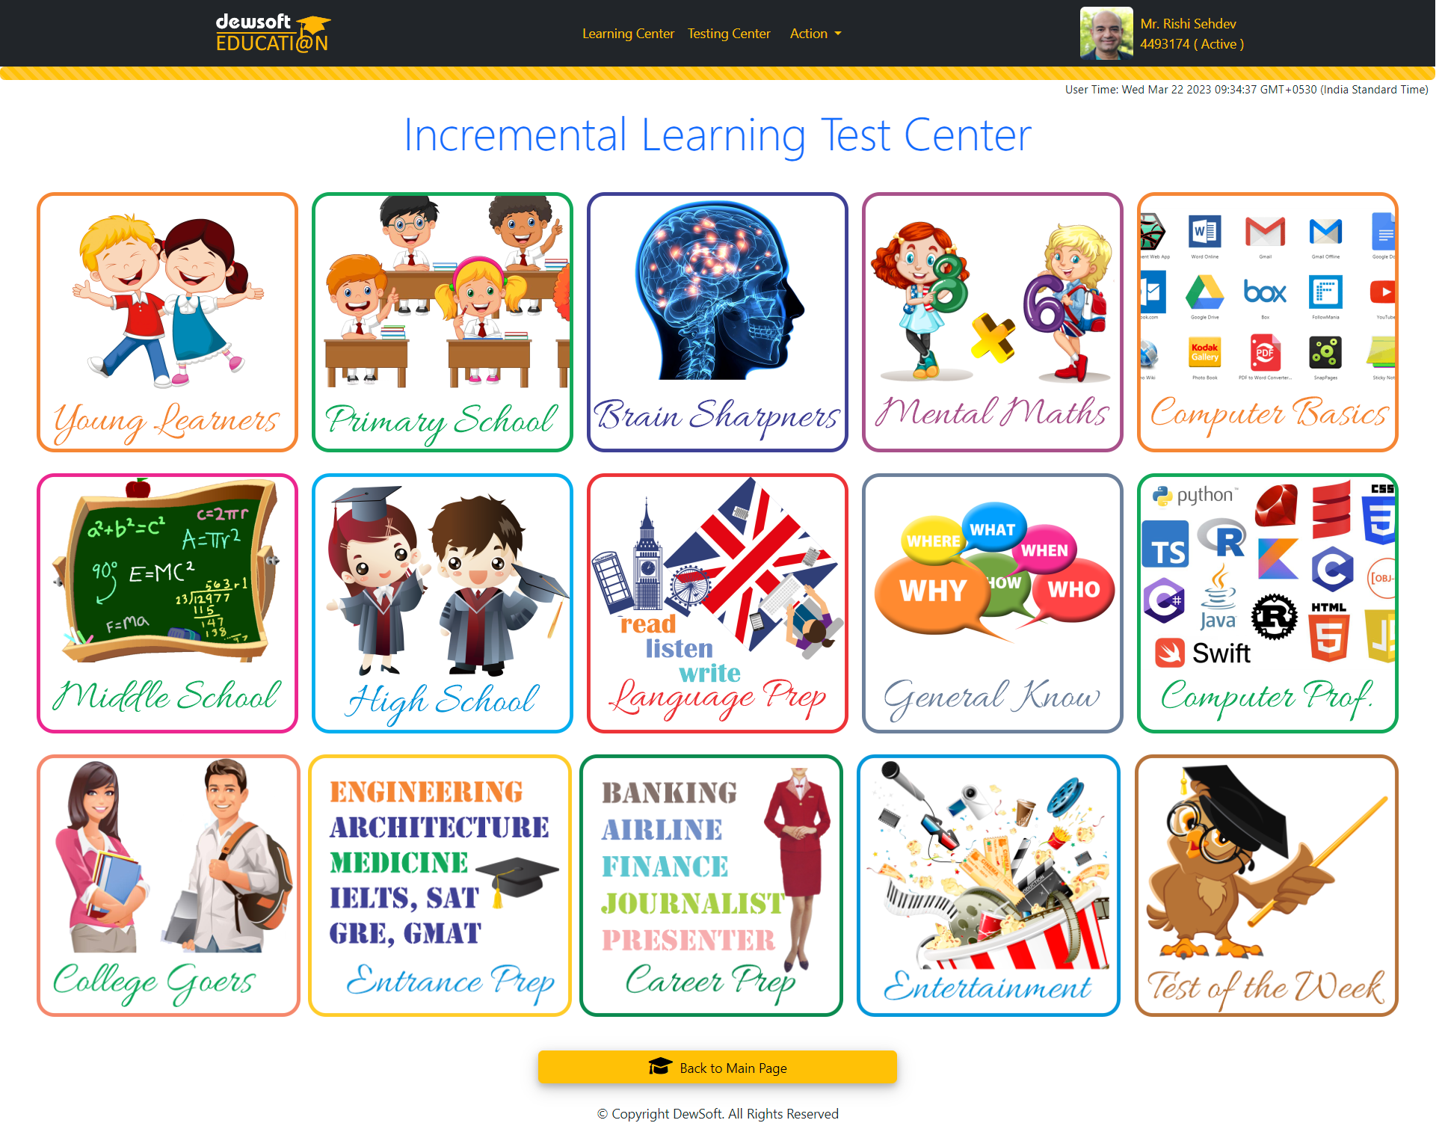
New Updates

Slide 14
Largest CBSE Chapter Based Q & As 20,000 plus Questions
For CBSE Class 9
For CBSE Class 10
For CBSE Class 11
For CBSE Class 12
At your finger tips 24x 7, Arranged Chapter wise for your Convenience
This Photo by Unknown Author is licensed under CC BY-SA
This Photo by Unknown Author is licensed under CC BY-SA
This Photo by Unknown Author is licensed under CC BY-SA
This Photo by Unknown Author is licensed under CC BY-SA

Slide 15
More Health and Taste through DewVital in 2023

Slide 16
Change Attitude, Change Lifestyle
Good Education: Learning is a lifelong Process. Learn something new everyday
Good Nutrition, daily exercise and adequate sleep are the foundations of healthy living.
A healthy lifestyle keeps you fit, energetic and enables you to take right decisions
Be Disciplined: Become a Regular, Don’t just prepare for events. Always be Prepared
Communicate Effectively : Be Polite and Be Prepared to Listen More
Write Your Goals : You will have a Direction
Make an Action Plan as per your Resources: You will definitely Achieve Your Goals

Slide 17
Let’s DewVitalize
Make Ourselves
Truly Healthy..
Wealthy.. and Wise
1

