Slide 1
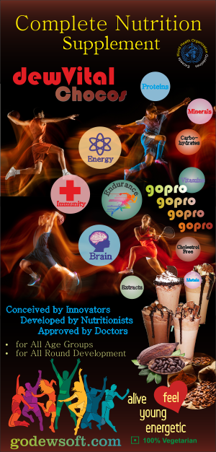
DewVital
Truly
Healthy..Wealthy..
and Wise
for the
entire family

Slide 2
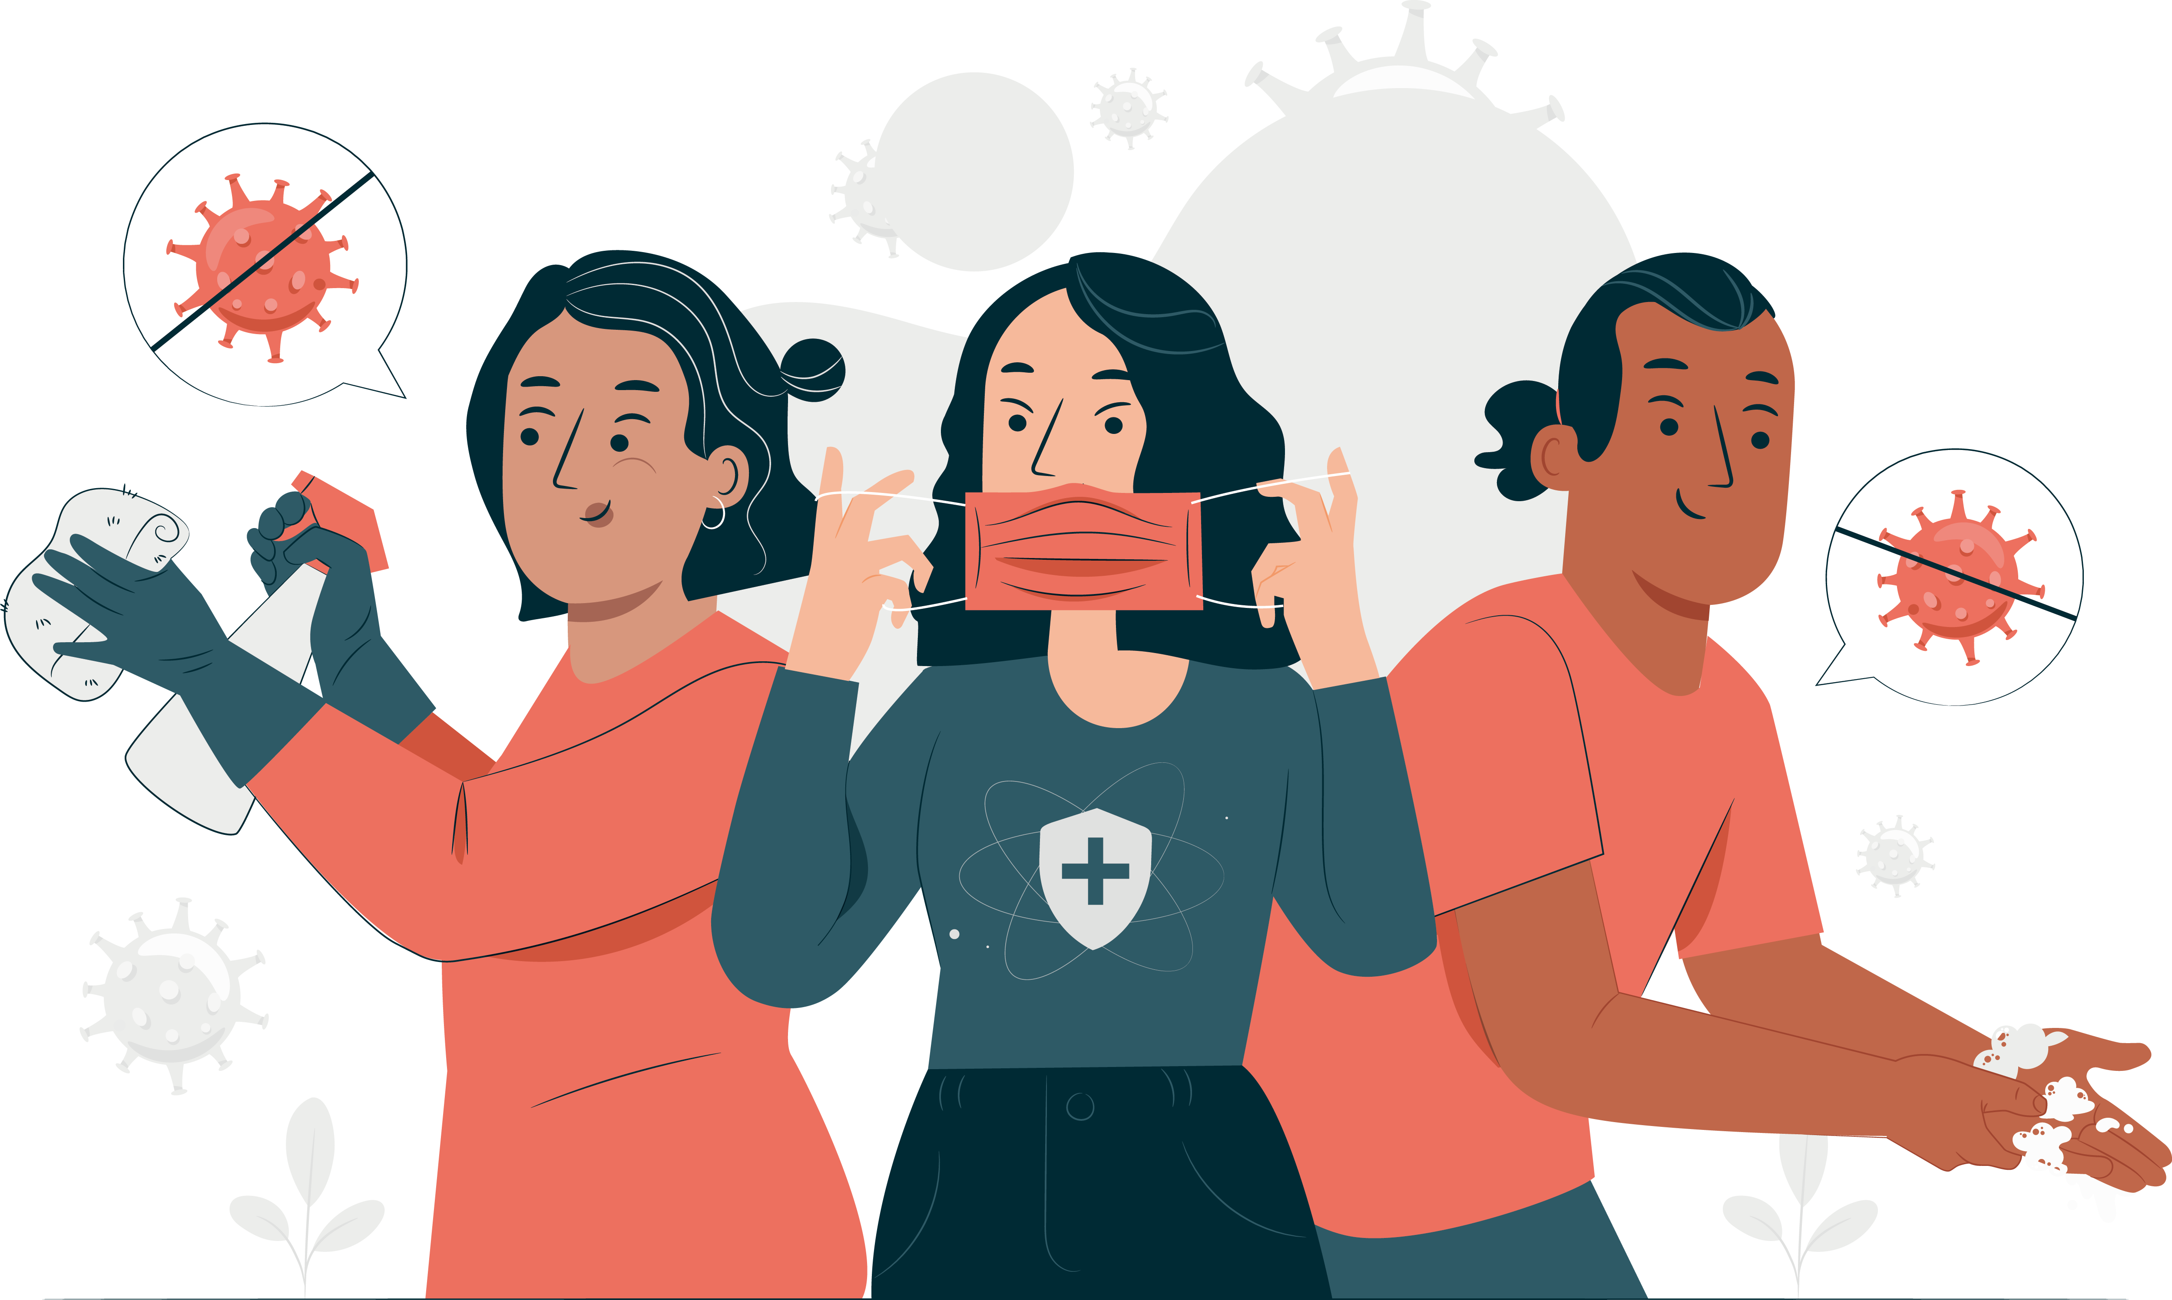
Year 2020
Exposed the mankind's unhealthy and unfit lifestyle
That we took health for granted
Businesses were shut.
Millions lost their lives around the world
Life will not be the same again…Ever
Corona 19
pandemic

Slide 3
The Idea
To Create a Tasty and Nutritious food Supplement
Developed by Health Professionals, Doctors, Nutritionists and Fitness Experts.
Immunity
Vigour
Stamina
Energy
Brain Activity

Slide 4
DewVital, What does it do?
Fulfils Special Demands of the Growing Body and Development of Brain from 2-16 years
Builds Immunity, Energy, Stamina and Enhanced Awareness for 02-85 years
Builds Immunity, Energy and Stamina for Pregnant Women and New Mothers
Assists in Tissue Repair, Body Healing, faster recovery for patients
Assists in Building Muscle, and increasing Stamina for training Athletes and Sports person
1

Slide 5
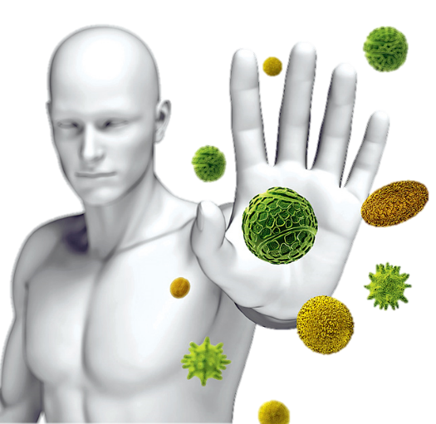
DewVitalize Yourself
for a healthy and happy life
for all age groups including expecting and new mothers, and all patients in recovery
Notes:
DewVital is a Complete Nutritional Supplement. Combine it with Regular 20-30 minute Exercise, its effect will start showing within 3-5 days. You will feel more fresh, energetic, and positive. A healthy body is must for a healthy mind or feeling good and Confidence, and together they are a winning combination for Chasing Your Dreams, living healthy, joyfully and confident everyday. Welcome to DewSoft, Welcome to a healthy, wealthy and wise way of life.

Slide 6
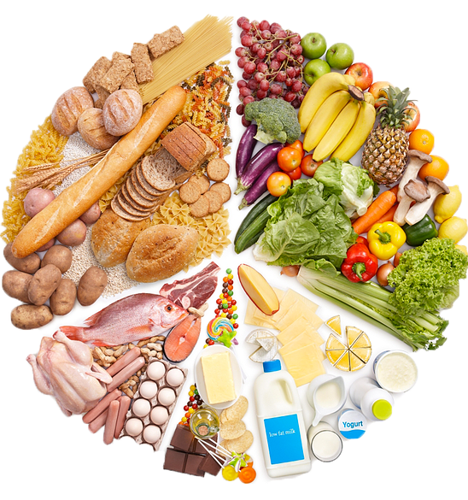
Sources of Nutrition
.
.
.
Minerals
and
Vitamins
Carbo-
hydrates
Proteins

Slide 7
What makes DewVital So Powerful?
Malt Based Goodness fortified with
Fat
Carbo-hydrates
MacroNutrients
Protein
Minerals
Vitamins
MicroNutrients
+
1

Slide 8
Understanding The Macronutrients
Proteins
Building block for development of Mind and Body.
15% plant-based SOY and regular Milk Protein.
Carbohydrates
Body’s primary fuel.
Fat
Fat is an energy reserve, for insulation and protection of your organs
BUILD and REGENERATE Tissue that includes cell membranes, organs, muscle, hair, skin, nails, bones, tendons, ligaments and blood plasma.
Involved in metabolic, hormonal and enzyme systems
Help maintain acid-base balance in our bodies.
RDA 56gm for men and 46gm for women.
Provide energy for muscles and the central nervous system during movement and exercise.
Medical Science believe 45-65% of calories per day should come from carbohydrates.
77 % of DewVital comprises of is easy to digest fibre rich Carbs, created through the goodness of malt and almost no sugar,
Provides instant and constant source of energy for all day long.
For absorption and transport of fat-soluble vitamins.
20-35% of your total daily calories should come from fat
found in butter, cooked vegetables and curries paranthas etc.
Excess FAT, is more harmful then beneficial. Causes blocked arteries, heart attacks
DewVital Contains 3% FAT naturally found in MALT, which is extremely beneficial and easy to digest.

Slide 9
Understanding The Micronutrients
Micronutrients are vitamins and minerals needed by the body in very small amounts.
Present in our everyday food.
Impact on a body’s health is critical.
Deficiency in any of them can cause severe and even life-threatening conditions.
Enables the body to produce enzymes, hormones and other substances needed for normal growth and development.
A
B1
B2
B12
C
D
K
Calcium
Phosphorus
Iron
Iodine
Copper

Slide 10
Micronutrient Deficiencies
Types of Vitamins | Deficiency Diseases
A (Retinol) | Night blindness
B1 (Thiamine) | Beri-beri
B2 (Riboflavin) | Retarded growth, bad skin
B12 (Cyanocobalamin) | Anaemia
C (Ascorbic acid) | Scurvy
D (Calciferol) | Rickets
K (Phylloquinone) | Excessive bleeding due to injury
Types of Minerals | Deficiency Diseases
Calcium | Brittle bones, excessive bleeding
Phosphorus | Bad teeth and bones
Iron | Anaemia
Iodine | Goitre, enlarged thyroid gland
Copper | Low appetite, retarded growth
Reductions in Energy Level, Mental Clarity and Overall Capacity
Reduced Educational Outcomes
Reduced Work Productivity
Increased risk from other diseases and health conditions.
Micronutrient Deficiencies are common around the world, irrespective of Age, Gender, and Social Economic status.
DewVital provides a perfect composition of all Micronutrients makes our regular diet healthy, fortified, and complete.
1

Slide 11
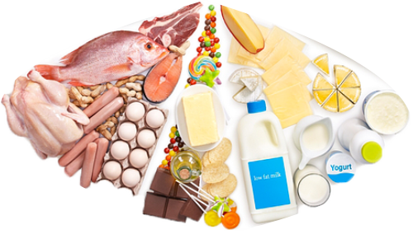
ZERO Cholesterol : Prevent Heart Diseases and Strokes
Found in meat, butter, cheese and other full-fat dairy products.
Cholesterol builds healthy cells
High cholesterol develops fatty deposits making it difficult for enough blood to flow through arteries.
Sometimes these deposits break, form a clot that causes a heart attack or stroke.
DewVital is completely Cholesterol free. Safe for consuming for all age groups, medical conditions, instead it gives you a healthy diet, and energy to do regular exercise, to prevent all lifestyle related diseases.
1

Slide 12
The Winning Formulae : The Complete Nutrition
2x Micro Nutrients
Zero Fatty Acids and Cholesterol
100% VEGETARIAN
3x Protein Multi Source
Malt Based 100% Clean Carbs

Slide 13
Change Attitude, Change Lifestyle
Good nutrition, daily exercise and adequate sleep are the foundations of healthy living.
A healthy lifestyle keeps you fit, energetic and at reduced risk for disease. Healthy living helps you enjoy more aspects of your life.
Health is not just about avoiding a disease or illness. It is about physical, mental and social well-being too.
DewSoftians can contribute to nutrition education, and help people become truly “Healthy, Wealthy and Wise”
1

Slide 14
Summary: DewVital
is a Complete Nutrition Supplement, capable of increasing
Energy and Stamina using Clean Source of Carbs
Mind and Body Development using Multiple Sources of Protein
Brain Activity and Awareness using Minerals and Vitamins
Builds Super Immunity and Strength
helps us
Recover Faster from existing diseases and Illness
Prevent Physical and Mental Illness
Chronic and Lifestyle Diseases
Live longer, Fuller, Fitter
Become Happy and Healthy
1

Slide 15
Let’s DewVitalize
Make Ourselves
Truly Healthy..
Wealthy.. and Wise
1

